Slide 1
Neuronal Dynamics: Computational Neuroscience of Single Neurons
Biological Modeling of Neural Networks
1.1 Neurons and Synapses:
Overview
1.2 The Passive Membrane
- Linear circuit
- Dirac delta-function
1.3 Leaky Integrate-and-Fire Model
1.4 Generalized Integrate-and-Fire Model
1.5. Quality of Integrate-and-Fire Models
Week 1 – neurons and mathematics:
a first simple neuron model
Wulfram Gerstner
EPFL, Lausanne, Switzerland

Slide 2
Biological Modeling of Neural Networks
1.1 Neurons and Synapses:
Overview
1.2 The Passive Membrane
- Linear circuit
- Dirac delta-function
1.3 Leaky Integrate-and-Fire Model
1.4 Generalized Integrate-and-Fire
Model
1.5. Quality of Integrate-and-Fire
Models
Notes:
Welcome!

Slide 3

Neuronal Dynamics – 1.1. Neurons and Synapses/Overview
motor
cortex
How do we recognize?
Models of cogntion
Weeks 10-14
frontal
cortex
visual
cortex
to motor
output

Slide 4
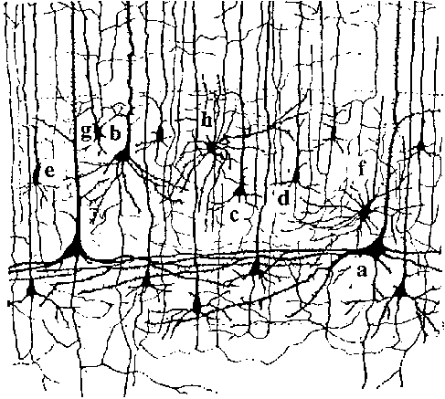
Neuronal Dynamics – 1.1. Neurons and Synapses/Overview
10 000 neurons
3 km wire
motor
cortex
1mm
frontal
cortex
to motor
output

Slide 5
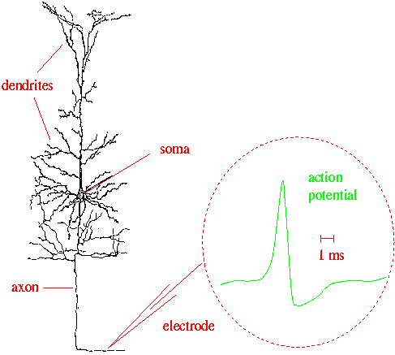
Neuronal Dynamics – 1.1. Neurons and Synapses/Overview
Signal:
action potential (spike)
10 000 neurons
3 km wire
1mm
action
potential
Ramon y Cajal

Slide 6
Neuronal Dynamics – 1.1. Neurons and Synapses/Overview
Hodgkin-Huxley type models:
Biophysics, molecules, ions
(week 2)
Signal:
action potential (spike)
-70mV
Na⁺
action
potential
K⁺
Ca²⁺
Ions/proteins

Slide 7
Neuronal Dynamics – 1.1. Neurons and Synapses/Overview
Signal:
action potential (spike)
action
potential

Slide 8
Neuronal Dynamics – 1.1. Neurons and Synapses/Overview
Integrate-and-fire models:
Formal/phenomenological
(week 1 and week 6+7)
Spike emission
Spike reception
synapse
t
-spikes are events
-triggered at threshold
-spike/reset/refractoriness
Postsynaptic
potential

Slide 9
Noise and variability in integrate-and-fire models
j
Spike emission
i
Output
-spikes are rare events
-triggered at threshold
Subthreshold regime:
trajectory of potential shows fluctuations
Random spike arrival

Slide 10
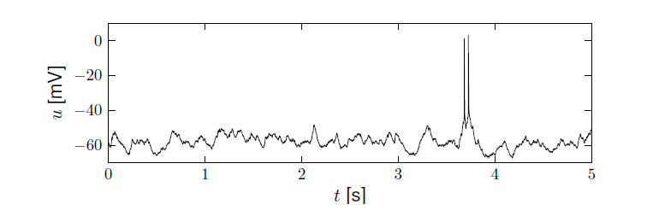
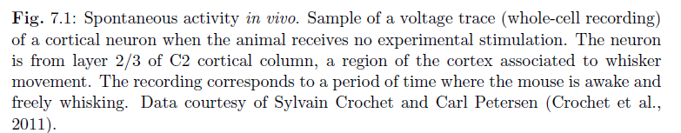
Neuronal Dynamics – membrane potential fluctuations
Spontaneous activity in vivo
electrode
What is noise?
What is the neural code?
(week 8+9)
Brain
awake mouse, cortex, freely whisking,
Crochet et al., 2011

Slide 11
Neuronal Dynamics – Quiz 1.1
A cortical neuron sends out signals which are called:
[ ] action potentials
[ ] spikes
[ ] postsynaptic potential
The dendrite is a part of the neuron
[ ] where synapses are located
[ ] which collects signals from other
neurons
[ ] along which spikes are sent to other
neurons
In an integrate-and-fire model, when the voltage hits the threshold:
[ ] the neuron fires a spike
[ ] the neuron can enter a state of
refractoriness
[ ] the voltage is reset
[ ] the neuron explodes
In vivo, a typical cortical neuron exhibits
[ ] rare output spikes
[ ] regular firing activity
[ ] a fluctuating membrane potential
Multiple answers possible!

Slide 12
Neural Networks and Biological Modeling – 1.1. Overview
Week 1: A first simple neuron model/
neurons and mathematics
Week 2: Hodgkin-Huxley models and
biophysical modeling
Week 3: Two-dimensional models and
phase plane analysis
Week 4: Two-dimensional models
Dendrites
Week 5,6,7: Associative Memory,
Learning, Hebb, Hopfield
Week 8,9: Noise models, noisy neurons
and coding
Week 10: Estimating neuron models for
coding and decoding
Week 11-14: Networks and cognitions
action
potential

Slide 13
Neural Networks and Biological modeling
Course: Monday : 9:15-13:00
have your laptop
with you
A typical Monday:
1st lecture 9:15-9:50
1st exercise 9:50-10:00
2nd lecture 10:15-10:35
2nd exercise 10:35-11:00
3rd lecture 11:15 – 11:40
3rd exercise 12:15-13:00
paper and pencil
paper and pencil
paper and pencil
OR interactive toy
examples on computer
Course of 4 credits = 6 hours of work per week
4 ‘contact’ + 2 homework
http://lcn.epfl.ch/
moodle.eplf.ch

Slide 14
Neural Networks and Biological Modeling
Questions?

Slide 15
Neuronal Dynamics: Computational Neuroscience of Single Neurons
Week 1 – part 2: The Passive Membrane
1.1 Neurons and Synapses:
Overview
1.2 The Passive Membrane
- Linear circuit
- Dirac delta-function
1.3 Leaky Integrate-and-Fire Model
1.4 Generalized Integrate-and-Fire Model
1.5. Quality of Integrate-and-Fire Models
Week 1 – neurons and mathematics:
a first simple neuron model
Wulfram Gerstner
EPFL, Lausanne, Switzerland

Slide 16
Neuronal Dynamics – 1.2. The passive membrane
electrode
Spike emission
synapse
t
potential
Integrate-and-fire model

Slide 17
Neuronal Dynamics – 1.2. The passive membrane
j
i
Spike reception
I
Subthreshold regime
- linear
- passive membrane
- RC circuit

Slide 18
Neuronal Dynamics – 1.2. The passive membrane
I(t)
Time-dependent input
i
I(t)
Math development:
Derive equation
u

Slide 19
Passive Membrane Model
I(t)
u

Slide 20
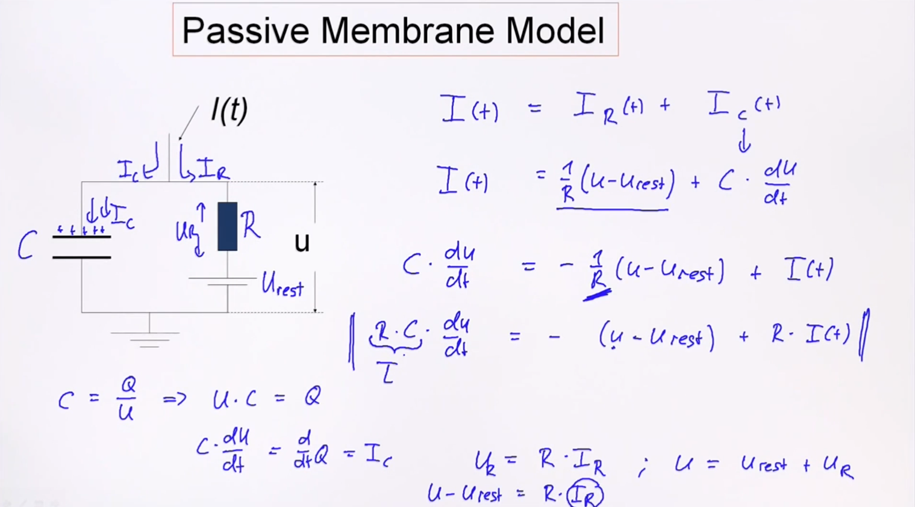
Notes:
一旦出现了一个电流I(t)输入，这个电路的电压值是怎么变化的？这里的输入的时间特别快，我们考虑的是变化的过程。
tau = R·C
其实最后得到了一个关于电压的平衡：Uc = -Ur – Ut
我们利用电容来得到这个电路的变换

Slide 21
Passive Membrane Model
j
i
I
Math Development:
Voltage rescaling

Slide 22
Passive Membrane Model

Slide 23
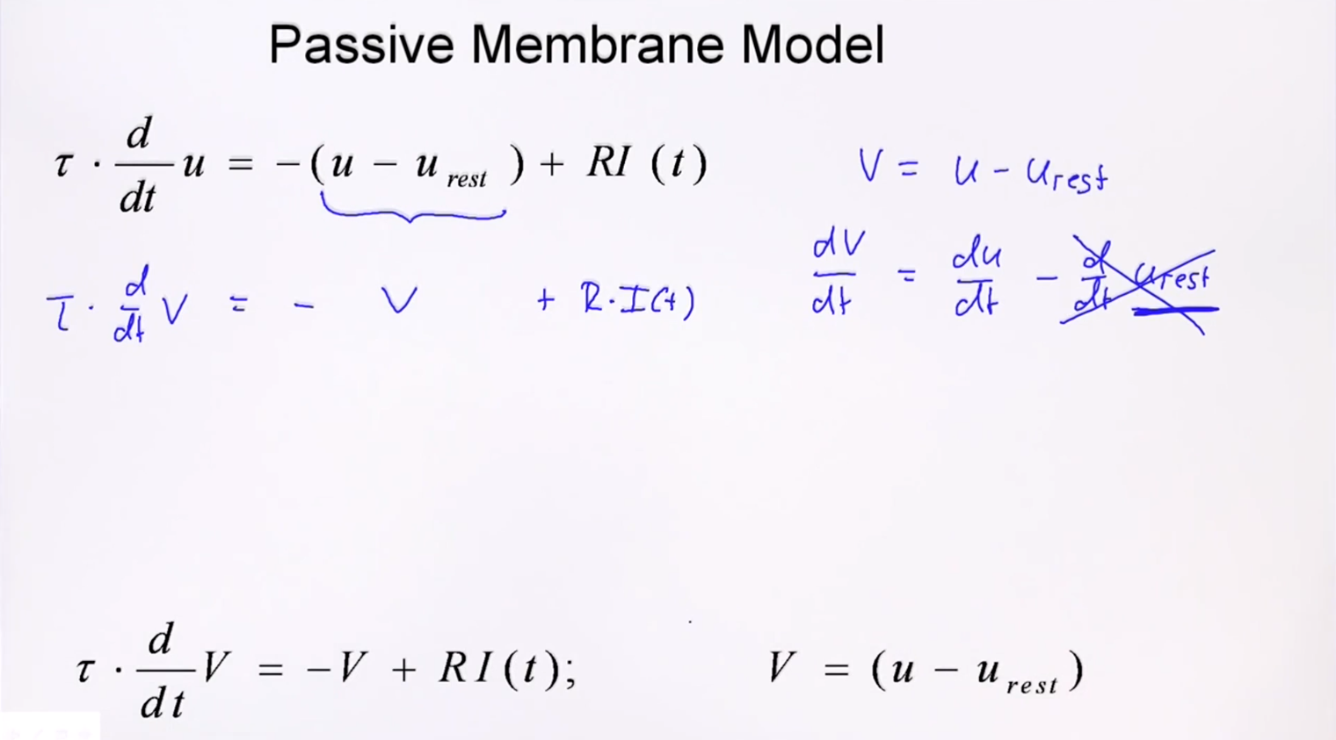

Slide 24
Passive Membrane Model/Linear differential equation
Free solution:
exponential decay

Slide 25
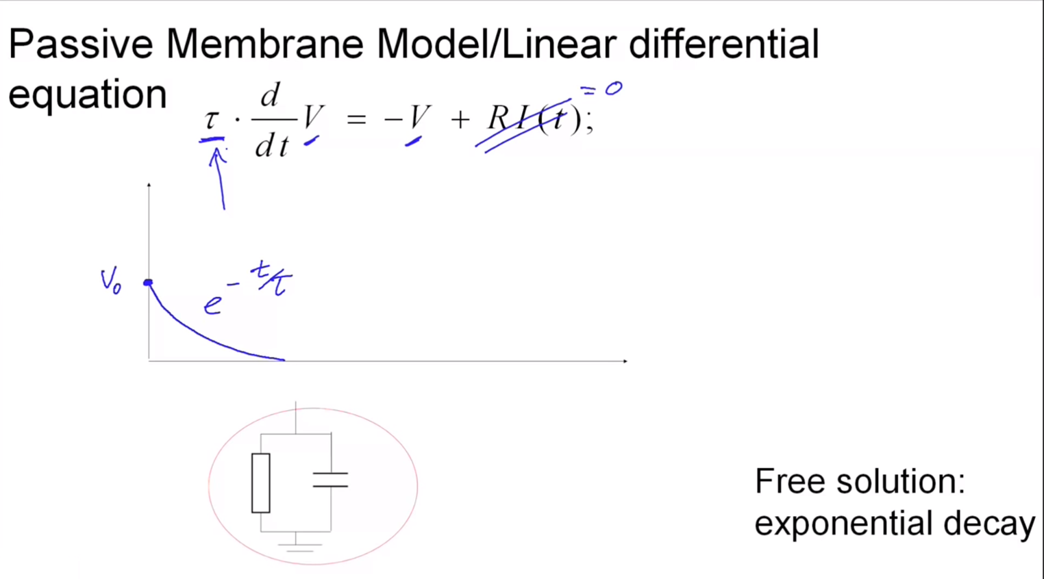

Slide 26
Triangle: neuron – electricity - math
i
I(t)
u

Slide 27
Pulse input – charge – delta-function
Pulse current input

Slide 28
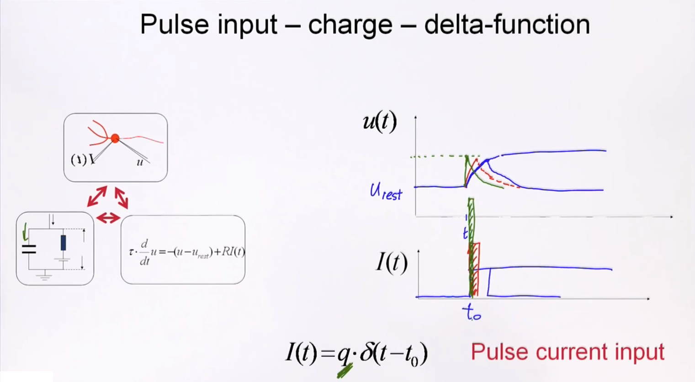
Notes:
用delta function来模拟（一次）

Slide 29
Dirac delta-function

Slide 30
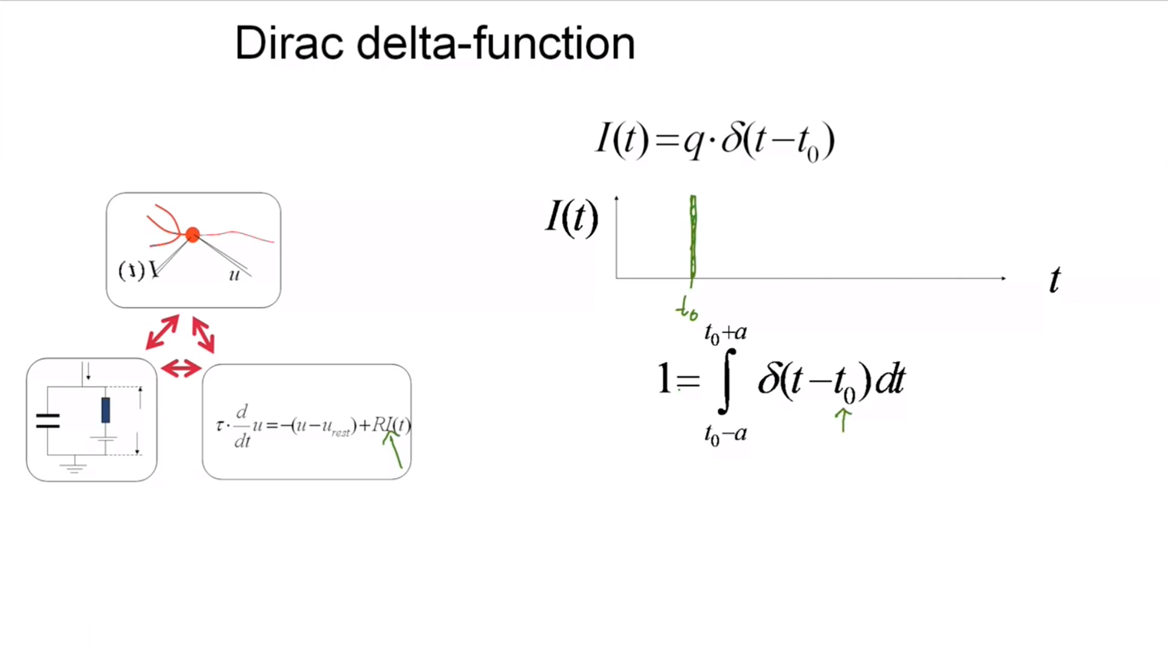

Slide 31
Neuronal Dynamics – Solution of Ex. 1 – arbitrary input
Arbitrary input
Single pulse
you need to know the solutions
of linear differential equations!

Slide 32
Start Exerc. at 9:47.
Next lecture at
10:15
Neuronal Dynamics – Exercises NOW
Step current input:
Pulse current input:
arbitrary current input:
Calculate the voltage,
for the
3 input currents

Slide 33
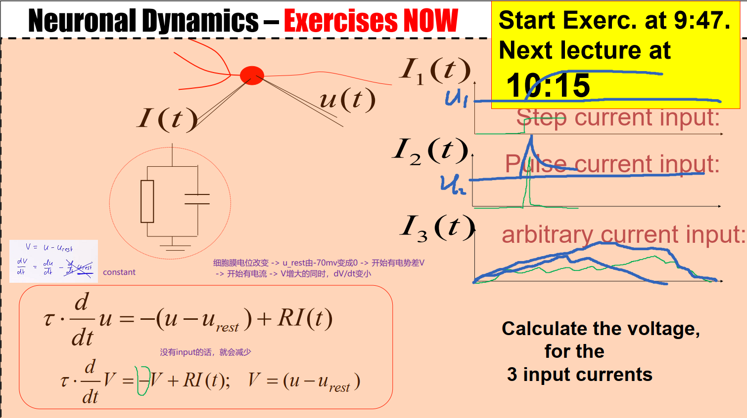
Notes:
细胞膜电位改变 -> u_rest由-70mv变成0 -> 开始有电势差V
-> 开始有电流 -> V增大的同时，dV/dt变小
没有input的话，就会减少

Slide 34
Passive Membrane Model – exercise 1 now
i
Step current input:
I(t)
TA’s:
Carlos Stein
Hesam Setareh
Samuel Muscinelli
Alex Seeholzer
impulse reception:
impulse response
function
Linear equation
Start Exerc. at 9:47.
Next lecture at
10:15

Slide 35
Passive membrane, linear differential equation

Slide 36
Passive membrane, linear differential equation
If you have difficulties,
watch lecture 1.2detour.
Three prerequisits:
Analysis 1-3
Probability/Statistics
Differential Equations or Physics 1-3 or Electrical Circuits

Slide 37
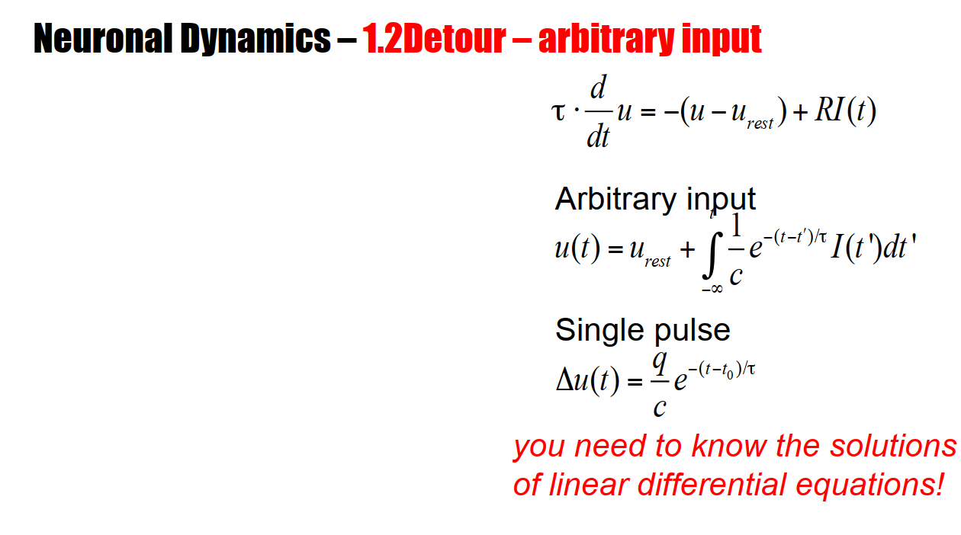
Notes:
This linear differential equation can be solved for arbitrary, time-dependent input. We can write down the general solution for arbitrary time-dependent input. Particularly interesting cases, in the context of neuroscience, are indeed the step current and the short pulse current.

Slide 38
Neuronal Dynamics: Computational Neuroscience of Single Neurons
Week 1 – part 2: Detour/Linear differential equation
1.1 Neurons and Synapses:
Overview
1.2 The Passive Membrane
- Linear circuit
- Dirac delta-function
- Detour: solution of 1-dim linear
differential equation
1.3 Leaky Integrate-and-Fire Model
1.4 Generalized Integrate-and-Fire
Model
1.5. Quality of Integrate-and-Fire
Models
Week 1 – neurons and mathematics:
a first simple neuron model
Wulfram Gerstner
EPFL, Lausanne, Switzerland

Slide 39
Neuronal Dynamics – 1.2Detour – Linear Differential Eq.

Slide 40
Neuronal Dynamics – 1.2Detour – Linear Differential Eq.
Math development:
Response to step current
I(t)
u

Slide 41
Neuronal Dynamics – 1.2Detour – Step current input
I(t)
u

Slide 42
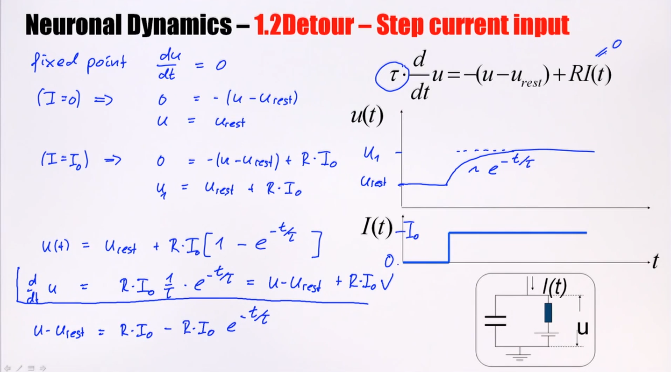
Notes:
The solution of a one-dimensional linear differential equation is an exponential.
1，左上：得到微分方程的初始情况
2，右上：解微分方程1，得u(t) = u_rest + B · e^(-t/τ) + R·I(t)
3，代入左上的初始情况，解出B = - R·I₀。得到方程2
后面是验证

Slide 43
Neuronal Dynamics – 1.2Detour – Short pulse input
short pulse:
Math development:
Response to short
current pulse
I(t)
u

Slide 44
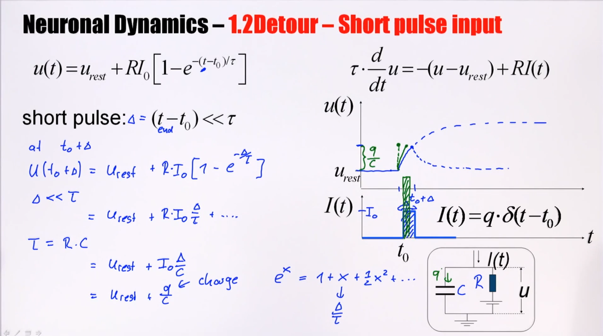
Taylor expansion
只保留前两项
Notes:
tau = R·C (define in slide page 20)
Physical interpretation: a positive current for a very short time.
If it's for a short time, the current does not have the time to go through the resistor. Instead, the current will basically just go on the capacity. That means, if I have a very short current pulse, this short current pulse deposits charge on the capacitor. If I deposit a charge Q on the capacitor, then I have a change in voltage, which corresponds to q/C.
也就是这里没有考虑到电阻，只是由于细胞膜的膜电位改变，导致出现了电子流动，形成电流。时间很短，还没有稳定下来，暂时还都在电容上。

Slide 45
Neuronal Dynamics – 1.2Detour – Short pulse input
short pulse:
I(t)
u

Slide 46
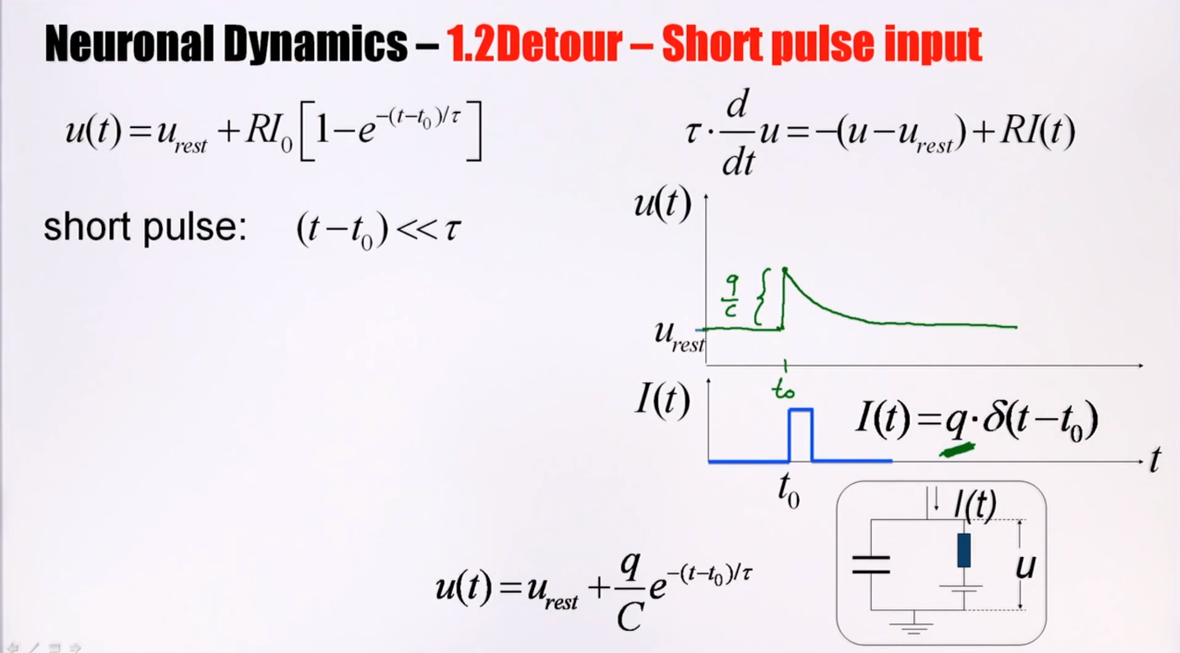
Notes:
Q is fixed
The jump is by an amount q/C. So the elegance of the Dirac delta function is that you don‘t need to work with short current pulses of finite duration. We can take the limit of a very short pulse and, then, forget the transient, and just say, it corresponds to a jump. This is a little bit like working with a somewhat lower time resolution.
In a physical situation, if you were to zoom in the pulse, in the end it does have some finite width. It‘s very short but still finite.
下面的式子是根据上面的解出来的

Slide 47
Neuronal Dynamics – 1.2Detour – arbitrary input
Single pulse
Multiple pulses:
Impulse response function,
Green’s function

Slide 48
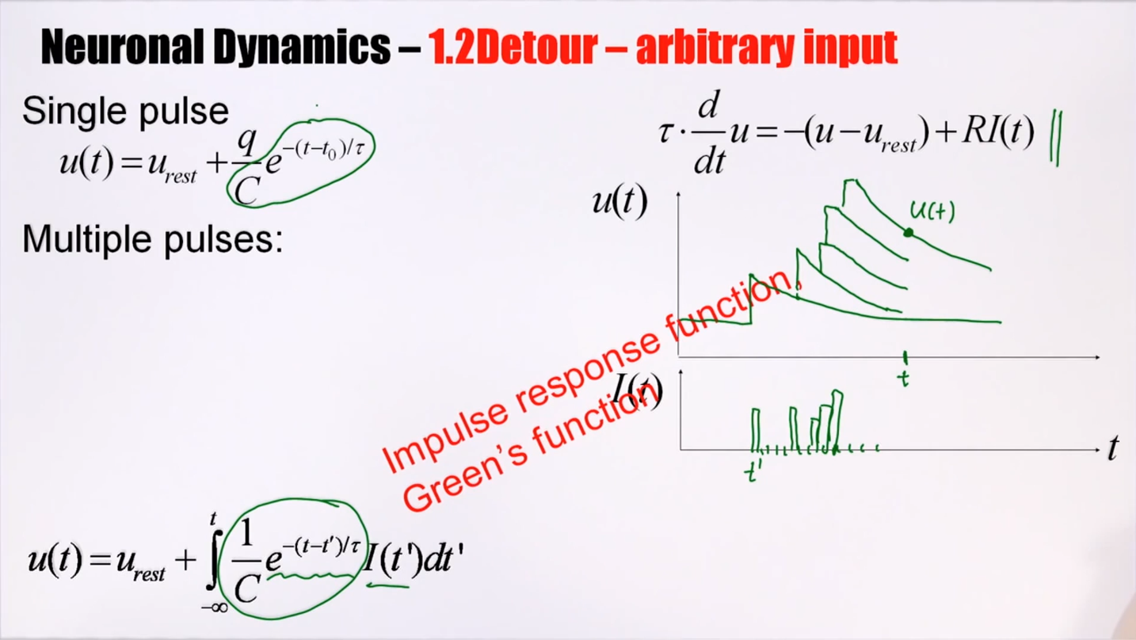
Notes:
Linear differential equation: The elementary solutions add up linearly.
What's the contribution of this pulse t’ to the voltage at time t?

Slide 49
Neuronal Dynamics – 1.2Detour – Greens function
Single pulse
Multiple pulses:
Impulse response function,
Green’s function

Slide 50
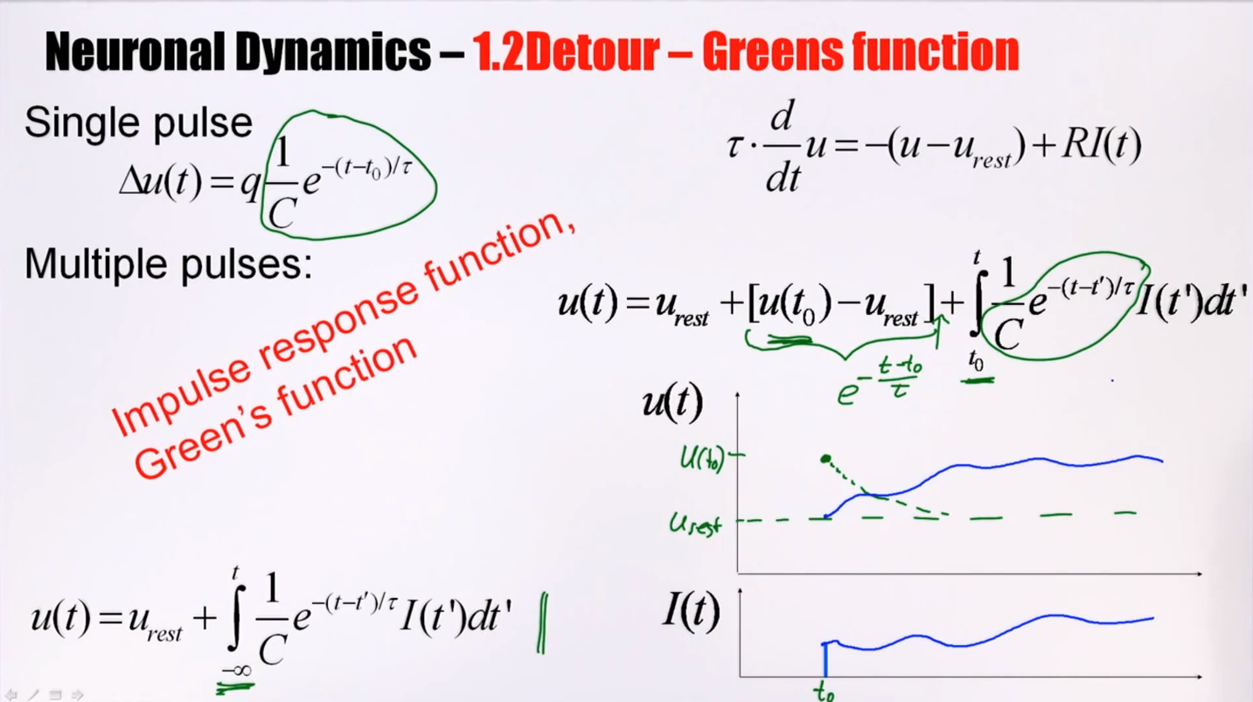
Notes:
给定一个初始值和任意t时刻的电流，我们可以得到在t时刻电压的状态。

Slide 51
Neuronal Dynamics – 1.2Detour – arbitrary input
Arbitrary input
Single pulse
you need to know the solutions
of linear differential equations!

Slide 52
Neuronal Dynamics – Exercises 1.2/Quiz 1.2
If you don’t feel at ease yet,
spend 10 minutes on these
mathematical exercises

Slide 53
Neuronal Dynamics: Computational Neuroscience of Single Neurons
Week 1 – part 3: Leaky Integrate-and-Fire Model
1.1 Neurons and Synapses:
Overview
1.2 The Passive Membrane
- Linear circuit
- Dirac delta-function
- Detour: solution of 1-dim linear
differential equation
1.3 Leaky Integrate-and-Fire Model
1.4 Generalized Integrate-and-Fire
Model
1.5. Quality of Integrate-and-Fire
Models
Week 1 – neurons and mathematics:
a first simple neuron model
Wulfram Gerstner
EPFL, Lausanne, Switzerland

Slide 54
Neuronal Dynamics – 1.3 Leaky Integrate-and-Fire Model
Notes:
Welcome back: in the previous part we have discussed the passive membrane. A model of passive membrane, is a reasonable description of some of the subthreshold phenomema observed in real neurons, but it cannot account for output spikes. In order to generate spikes, we need to introduce the notion of a threhold.

Slide 55
Neuronal Dynamics – Integrate-and-Fire type Models
Spike emission
Input spike causes an EPSP
= excitatory postsynaptic potential
Simple
Integrate-and-Fire Model:
passive membrane
+ threshold
output spikes are events
generated at threshold
after spike: reset/refractoriness
Leaky Integrate-and-Fire Model
Notes:
The simplest integrate-and-fire model is a passive membrane combined with a threshold.

Slide 56
Neuronal Dynamics – 1.3 Leaky Integrate-and-Fire Model
Spike emission
j
i
reset
I
linear
Fire+reset
threshold

Slide 57
Neuronal Dynamics – 1.3 Leaky Integrate-and-Fire Model
I(t)
Time-dependent input
i
Math development:
Response to step current
I(t)
-spikes are events
-triggered at threshold
-spike/reset/refractoriness

Slide 58
Neuronal Dynamics – 1.3 Leaky Integrate-and-Fire Model
I(t)
CONSTANT input/step input
i
I(t)
I(t)

Slide 59
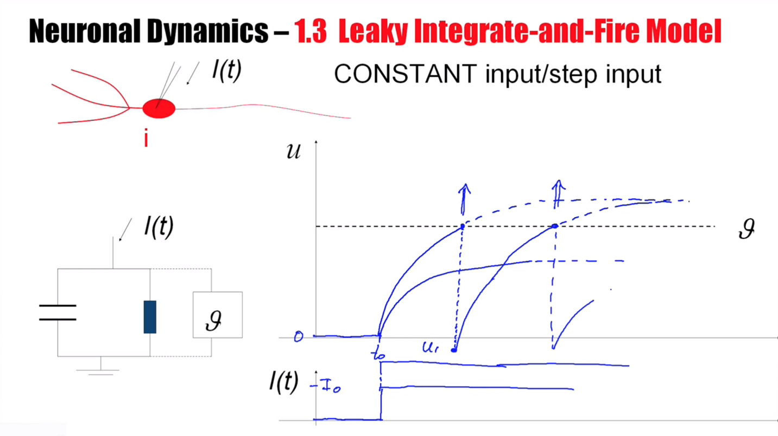

Slide 60
Leaky Integrate-and-Fire Model (LIF)
LIF
If
‘Firing’
Repetitive, current I0
u
T
1/T
frequency-current
relation
t
Repetitive, current I1> I0
u
f-I curve
t
I

Slide 61
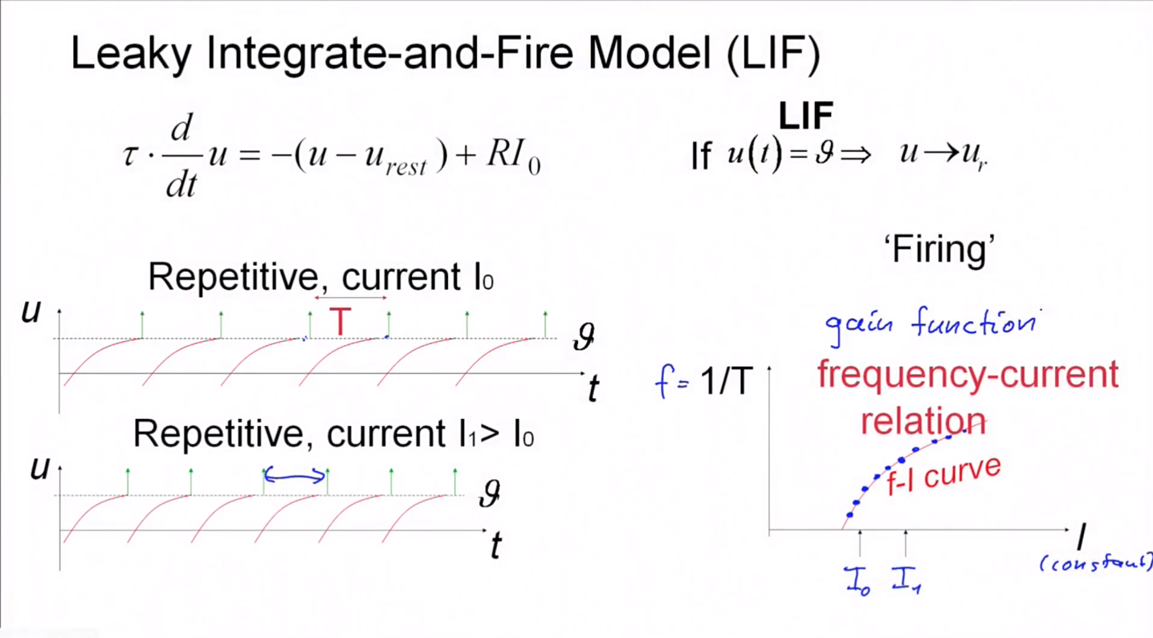

Slide 62
Neuronal Dynamics – First week, Exercise 2
frequency-current
relation
1/T
f-I curve
I

Slide 63
EXERCISE 2 NOW: Leaky Integrate-and-fire Model (LIF)
LIF
If firing:
Exercise:
Calculate the interspike interval T for constant input I. Firing rate is f = 1/T. Write f as a function of I.
What is the frequency-current curve f=g(I) of the LIF?
repetitive
u
t
Start exercese at 10:55.
Next lecture at 11:15.

Slide 64
Neuronal Dynamics: Computational Neuroscience of Single Neurons
Week 1 – part 4: Generalized Integrate-and-Fire Model
1.1 Neurons and Synapses:
Overview
1.2 The Passive Membrane
- Linear circuit
- Dirac delta-function
1.3 Leaky Integrate-and-Fire Model
1.4 Generalized Integrate-and-Fire
Model
1.5. Quality of Integrate-and-Fire
Models
Week 1 – neurons and mathematics:
a first simple neuron model
Wulfram Gerstner
EPFL, Lausanne, Switzerland

Slide 65
Neuronal Dynamics – 1.4. Generalized Integrate-and Fire
Spike emission
reset
Integrate-and-fire model
LIF: linear + threshold
Notes:
In the previous lecture, we have see the leaky integrate-and-fire model: The responses to incoming spikes are summed LINEARLY, until a threshold is reached.
Let us now look again at the leaky IF, but from a slighlty different perspective

Slide 66
Neuronal Dynamics – 1.4. Leaky Integrate-and Fire revisited
I=0
I>0
LIF
If firing:
u
resting
repetitive
u
u
t
t
Notes:
The LIF is characterized by a linear differential equation.

Slide 67
Neuronal Dynamics – 1.4. Nonlinear Integrate-and Fire
LIF
NLIF
If firing:

Slide 68
Neuronal Dynamics – 1.4. Nonlinear Integrate-and Fire
Nonlinear
Integrate-and-Fire
I=0
I>0
NLIF
u
u
Firing:

Slide 69
Nonlinear Integrate-and-fire Model
Spike emission
j
i
F
reset
I
NON-linear
Fire+reset
threshold

Slide 70
Nonlinear Integrate-and-fire Model
I=0
I>0
u
u
Quadratic I&F:
NON-linear
Fire+reset
threshold

Slide 71
Nonlinear Integrate-and-fire Model
I=0
I>0
u
u
Quadratic I&F:
exponential I&F:
Fire+reset

Slide 72
Nonlinear Integrate-and-fire Model
I=0
u
exponential I&F:
NONlinear
Fire+reset
threshold

Slide 73
Nonlinear Integrate-and-fire Model
Where is the firing threshold?
I=0
I>0
u
u
resting
u
t
t
Notes:
The firing threshold, θ, for the voltage. And this is different from θ_r. θ_r is the numerical threshold for the reset. Its value is somewhat arbitrary. I could put it further up.
I can put it slightly further down. It doesn't really matter, because the increase of the voltage is so rapid that it will blow up very rapidly.
A pulse input just makes the jump of the membrane potential to a new value. If this jump is to a value below theta, it will go back. If the jump is to a value above theta, the voltage will increase further
Where is the firing threshold?
For leaky integrate-and-fire model, it's simple. There is only one threshold. The threshold for the reset is the same as the threshold for pulse input. It's the same as the threshold for constant input.
For nonlinear integrate-and-fire models, the picture is more complicated. The neuron has a formal threshold for the reset, which is of minor importance. What is important is the intrinsic threshold. And this intrinsic threshold is different for the case of pulse input, initial condition. It corresponds to the crossing point at the intersection point of the green curve. It's different for pulse input and for constant input. Therefore, a nonlinear integrate-and-fire model does not have a unique firing threshold.

Slide 74
Neuronal Dynamics: Computational Neuroscience of Single Neurons
Week 1 – part 5: How good are Integrate-and-Fire Model?
1.1 Neurons and Synapses:
Overview
1.2 The Passive Membrane
- Linear circuit
- Dirac delta-function
1.3 Leaky Integrate-and-Fire Model
1.4 Generalized Integrate-and-Fire
Model
- where is the firing threshold?
1.5. Quality of Integrate-and-Fire
Models
- Neuron models and experiments
Week 1 – neurons and mathematics:
a first simple neuron model
Wulfram Gerstner
EPFL, Lausanne, Switzerland

Slide 75
Neuronal Dynamics – 1.5.How good are integrate-and-fire models?
Can we compare neuron models
with experimental data?

Slide 76
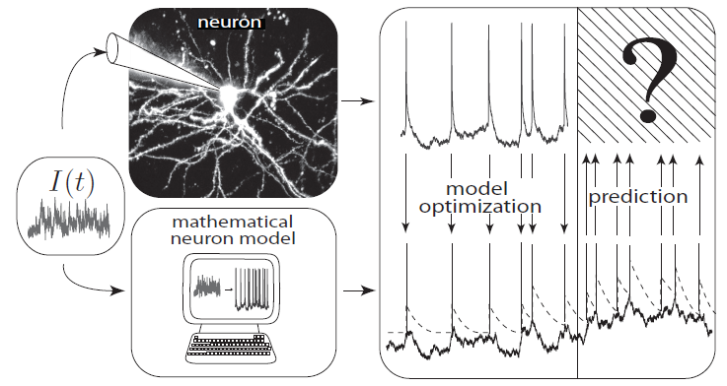
Neuronal Dynamics – 1.5.How good are integrate-and-fire models?
What is a good neuron model?
Can we compare neuron models
with experimental data?
Notes:
What is a good neuron model? Would the nonlinear integrate-and-fire model be good?
Ideally, from a model of this kind, I would expect that if I inject a current into a real neuron, I can record the response. And I can use the response to optimize the parameters of my mathematical neuron model. But then the model should be good to make predictions.

Slide 77
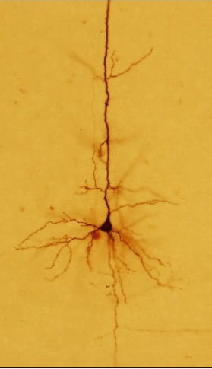
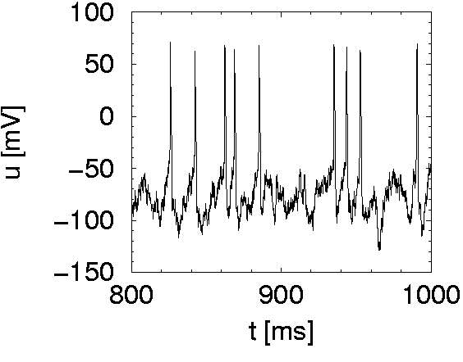
Neuronal Dynamics – 1.5.How good are integrate-and-fire models?
I(t)
Spike
Integrate-and-fire model
Notes:
I would like the model to predict the spike times correctly, spike by spike.

Slide 78
Nonlinear Integrate-and-fire Model
I=0
Can we measure
the function F(u)?
u
Quadratic I&F:
exponential I&F:
Fire+reset
Notes:
Well the first question is, what would be a good integrate-and-fire model? What's the right type of non-linearity?
What is the correct form of the function F, if we compare with experimental data?

Slide 79
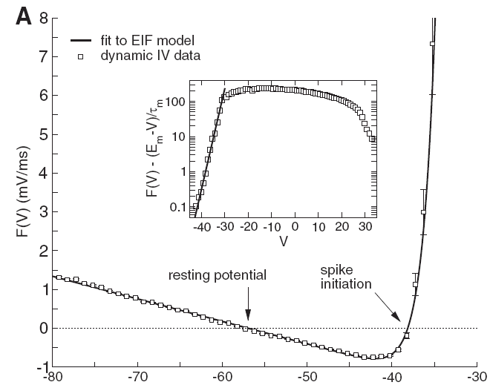
Neuronal Dynamics – 1.5.How good are integrate-and-fire models?
voltage
I(t)
u [mV]
Badel et al., J. Neurophysiology 2008
Notes:
What is a good neuron model? Would the nonlinear integrate-and-fire model be good?
In recordings of neurons in a slice, it's possible to inject a time-dependent current. It's a fluctuating current like we would expect a neuron to receive in an in viva situation.
So this fluctuating current is injected in the neuron with the first electrode. And with a second electrode, the voltage is recorded. Now since you know the current and since you know the voltage, you can essentially extract the function F(u) over many, many data points.

Slide 80
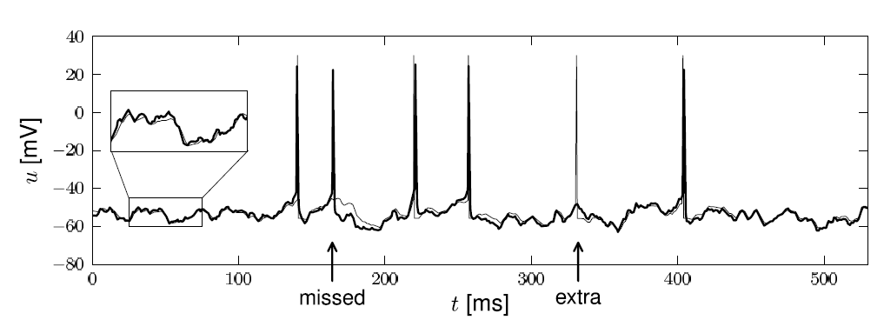
Neuronal Dynamics – 1.5.How good are integrate-and-fire models?
Notes:
The neuron model and the real data. That real data is the thick line, the neuron model is the thin line.
Moreover, many of the spike times occur at the correct moment. There are a few missed spikes, there are a few extra spikes. But overall, about 90% of the spike times, of the predictable spike times, can be predicted by this type of neuron model.

Slide 81
Neuronal Dynamics – 1.5.How good are integrate-and-fire models?
Nonlinear integrate-and-fire models
are good
Mathematical description → prediction
Need to add
- adaptation
- noise
- dendrites/synapses
Computer ecercises:
Python
Notes:
What is a good neuron model? Would the nonlinear integrate-and-fire model be good?

Slide 82
Neural Networks and Biological - Exercise 3
I=0
Homework!
u

Slide 83
Neuronal Dynamics – References and Suggested Reading
Reading: W. Gerstner, W.M. Kistler, R. Naud and L. Paninski,
Neuronal Dynamics: from single neurons to networks and
models of cognition. Chapter 1: Introduction. Cambridge Univ. Press, 2014
Selected references to linear and nonlinear integrate-and-fire models
- Lapicque, L. (1907). Recherches quantitatives sur l'excitation electrique des nerfs traitee comme une polarization. J. Physiol. Pathol. Gen., 9:620-635.
Stein, R. B. (1965). A theoretical analysis of neuronal variability. Biophys. J., 5:173-194.
-Ermentrout, G. B. (1996). Type I membranes, phase resetting curves, and synchrony.
Neural Computation, 8(5):979-1001.
Fourcaud-Trocme, N., Hansel, D., van Vreeswijk, C., and Brunel, N. (2003). How spike generation mechanisms determine the neuronal response to fluctuating input.
J. Neuroscience, 23:11628-11640.
Badel, L., Lefort, S., Berger, T., Petersen, C., Gerstner, W., and Richardson, M. (2008). Biological Cybernetics, 99(4-5):361-370.
- Latham, P. E., Richmond, B., Nelson, P., and Nirenberg, S. (2000). Intrinsic dynamics in neuronal networks. I. Theory. J. Neurophysiology, 83:808-827.

